Slide 1
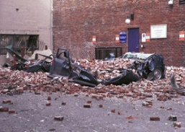
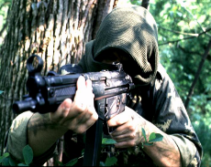
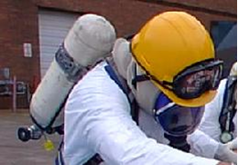
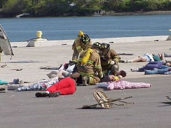
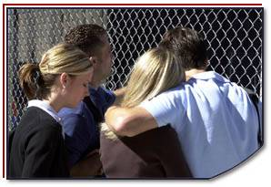
Disaster Site Worker Safety
Incident Command System (ICS) / Unified Command (U/C)

Slide 2
Objectives
Explain the need for an Incident Command System (ICS).
Describe the arrangement of the incident command organization.
Describe the functional areas of command.
Understand Your “Function” within the command structure.

Slide 3
Command Considerations
What type of Incident is it…
What is the Life Safety Hazard…
Always be aware of weather conditions at the incident site.
How large can this incident get…
What resources are needed to mitigate and remediate the incident...

Slide 4
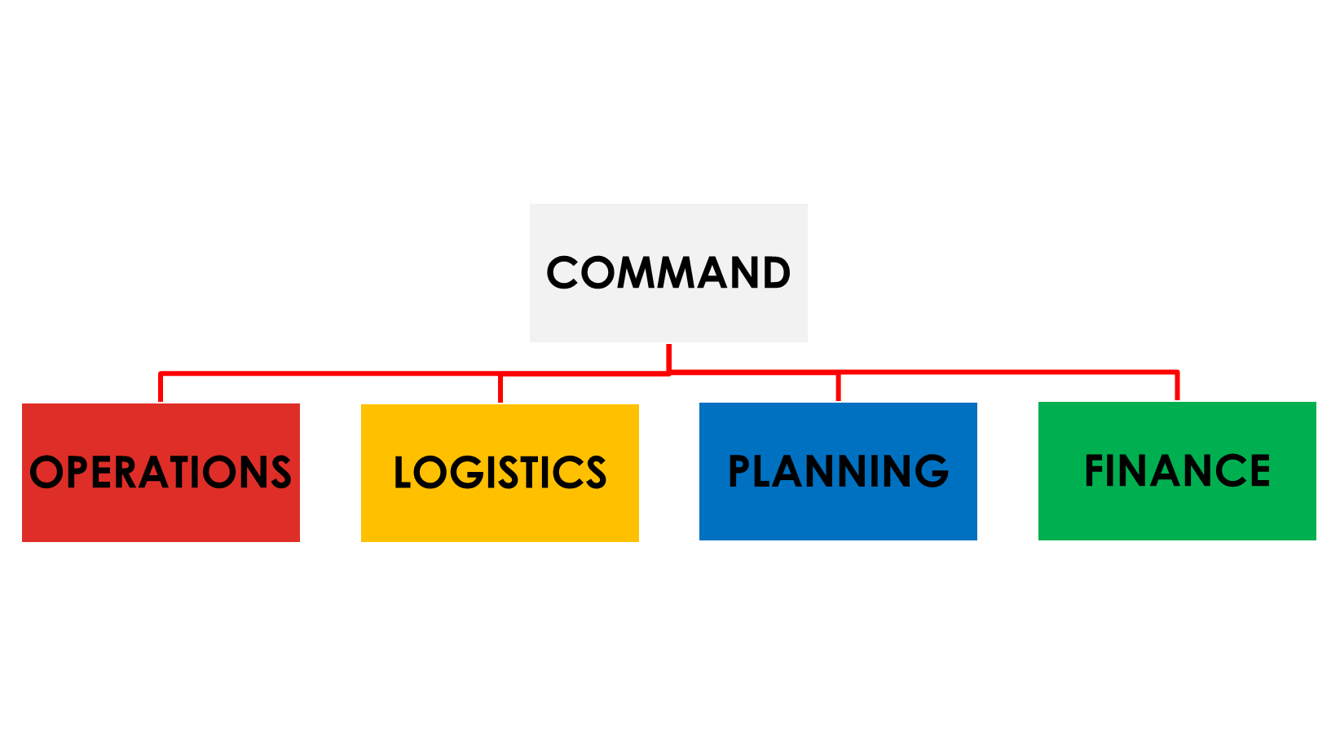
Incident Command
Incident Command System (ICS)
Is a management system designed to enable effective and efficient domestic incident management by integrating a combination of facilities, equipment, personnel, procedures, and communications operating within a common organizational structure.

Slide 6
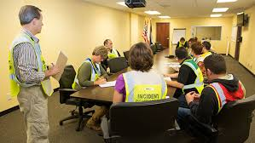
Incident Command System
ICS has evolved into an all-risk/all-hazard, response system that is appropriate for all emergencies.
Federal law requires the use of an Incident Management System in response to Hazmat incidents.
Experience has shown that those incidents managed in a systematic way are the most successful at achieving the intended goals.

Slide 7
Incident Command System
COMMAND
LOGISTICS
FINANCE
PLANNING
OPERATIONS
ICS is the framework necessary to manage the resources, personnel, apparatus, and equipment used to mitigate an event.
Today it is especially critical to know exactly what steps to take and the sequence in which they must occur because of the presence of hazards other than those traditionally encountered.
BOSS
GETTERS
PAYERS
THINKERS
DOERS

Slide 8
The Command Function
COMMAND
Establishes incident objectives, strategies and priorities.
Assumes overall responsibility for the incident.
OPERATIONS
Determines tactics and recourses for achieving objectives.
Directs the tactical response.
PLANNING
Collects and analyzes information,
Tracks resources and maintains documentation
LOGISTICS
Provides resources and needed services.
FINANCE / ADMINISTRATION
Accounts for expenditures, claims, compensation.
Provides procurement needed resources.
Administration may include Legal oversite.
COMMAND
LOGISTICS
FINANCE
PLANNING
OPERATIONS

Slide 9
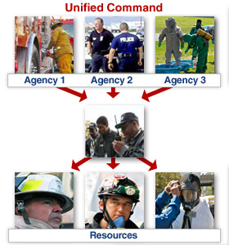
Unified Command
Unified Command (UC)
In the Incident Command System, a Unified Command is an authority structure in which the role of incident commander is shared by two or more individuals, each already having authority in a different responding agency.
Allows IC’s to make joint decisions by establishing a single command structure
Maintains unity of command. Each employee reports to only one supervisor.

Slide 10
National Incident Management System
National Incident Management System (NIMS)
Establishes standardized incident management processes, protocols, and procedures that all responders -- Federal, state, tribal, and local -- will use to coordinate and conduct response actions.
Responders use the same standardized procedures, they will all share a common focus, and will be able to place full emphasis on incident management when a homeland security incident occurs -- whether terrorism or natural disaster.
Notes:
In addition, national preparedness and readiness in responding to and recovering from an incident is enhanced since all of the Nation's emergency teams and authorities are using a common language and set of procedures.

Slide 11
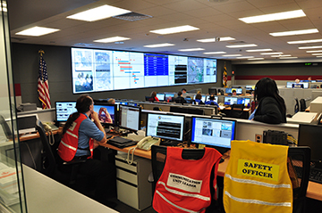
Emergency Operations Center (EOC)
Emergency Operations Centers (EOC’s)
Provide a large scale view of the entire disaster site enabling all support functions of the incident command system/Unified Command System.
The National Command System work together in a “three dimensional atmosphere” or an interactive environment.

Slide 12
Local Government Response Plans
Large scale events will require enacting Emergency Response Plans at State and Federal levels.
The plan should include a focus on:
Public protection
Emergency services
Restoration of critical public systems
Field assessment capabilities
Ability to declare a local disaster/emergency

Slide 13
Activating the Federal Response Plan
Federal assistance requested by a governor
Emergency or disaster overwhelms local and state resources
A forecasted major event
Democratic / Republic National Convention
Super Bowl / Olympics
Hurricane

Slide 14
Restoration Operations
Disaster Site Worker will fall within the Restoration Operations function of the ICS
Focus of restoration operations is to return the community to pre-incident conditions.
Begins upon completion of the survey for contamination and continues until all contamination is eliminated.
Challenges include the restoration of the site with the emphasis on site safety managing and the creation and implementation of a site specific Health and Safety Plan (HASP).
OSHA Quick Card – NRF-6 “Protecting Worker Safety and Health Under the National Response Framework”

Slide 15
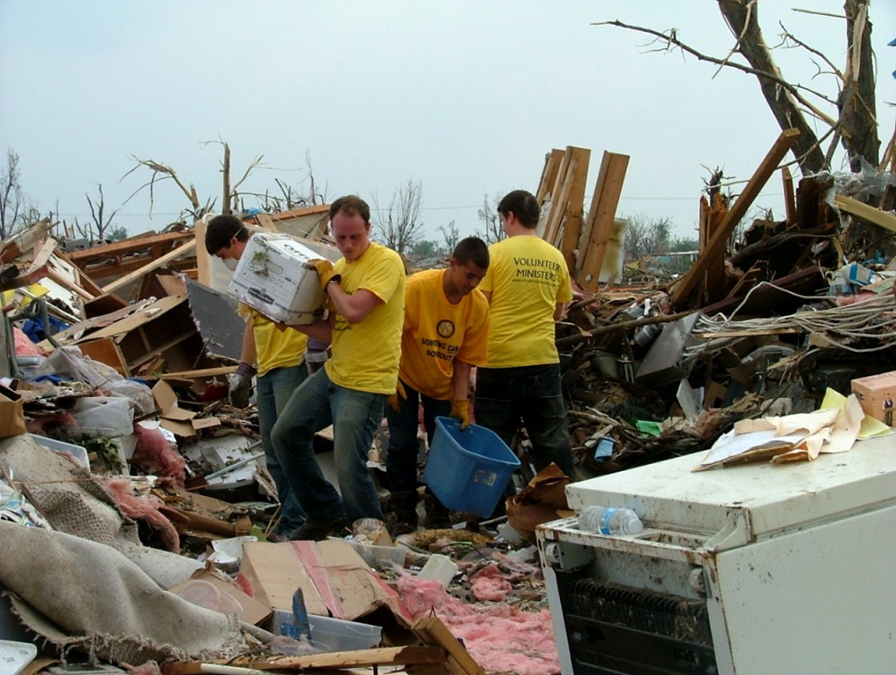
Restoration Operations
COMMAND
LOGISTICS
FINANCE
PLANNING
OPERATIONS
EMERGENCY OPERATIONS
RESTORATION OPERATIONS
Search & Rescue Group
Medical Group
Perimeter Security Group
Debris Removal Group
Utility Group
Transportation Group

Slide 16
Accountability failures
Self Dispatching / Freelancing
Unfortunately, well meaning organizations often “self dispatch” themselves to incidents without coordination with the Incident Commanders.
Repetitive Details / Assignments
Results often lead to counter productive activities by the workers.
Duplication of tasks are wasted money & manpower.
Unassigned Resources
Resources will be staged without assignment and fail to help those in need.
Unreported Injuries & Illness
Without accurate accountability, injuries and long term health issues cannot be supported if they should arise.

Slide 17
Review
Safe work practices are the key to a successful disaster site worker operation.
The Disaster Site Worker plays an important roll in the recovery efforts of a disaster site. Following the ICS program requirements once the group arrives through the time they depart will insure a safer and well documented work site for accountability of the on scene worker.

Slide 18
ACTIVITY
COMPLETE THE ICS CHART:
COMMAND
OPERATIONS
LOGISTICS
PLANNING
FINANCE

Slide 19
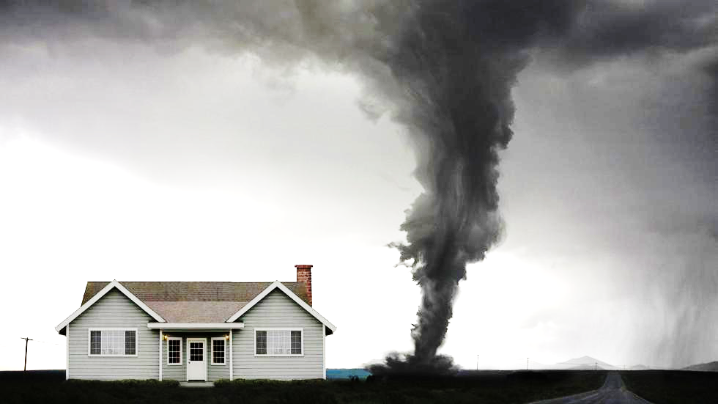
Dashboard
TRAUMATIC STRESS

